Slide 1

MY Recipe Angular Project

Slide 2
Agenda
Abstract
Implementation design
Snapshots

Slide 3
Abstract
MyRecipe is an online food recipebook website .
There are two types of user a. User b. Admin
User Flow Home page contains list of food items. And also filter the products using the food type. On clicking the food item, it redirect to details page that contains name, description, time, Instruction and Nutrition and reviews of the particular food recipe. Contact page is there to send your queries.
Admin Flow In Admin Page, admin can add or update or delete the foods recipe items

Slide 4
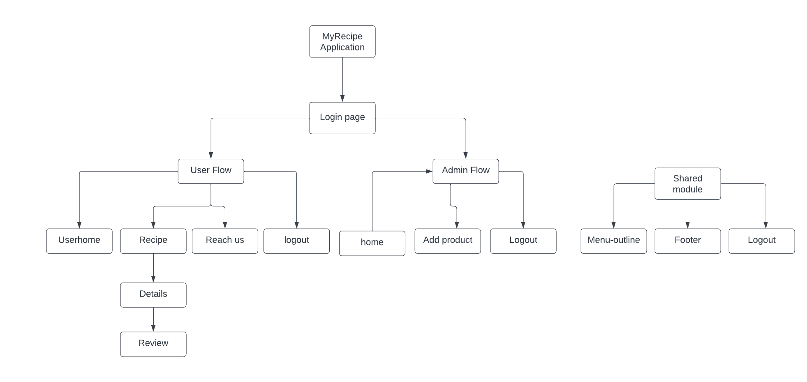
Implementation design

Slide 5
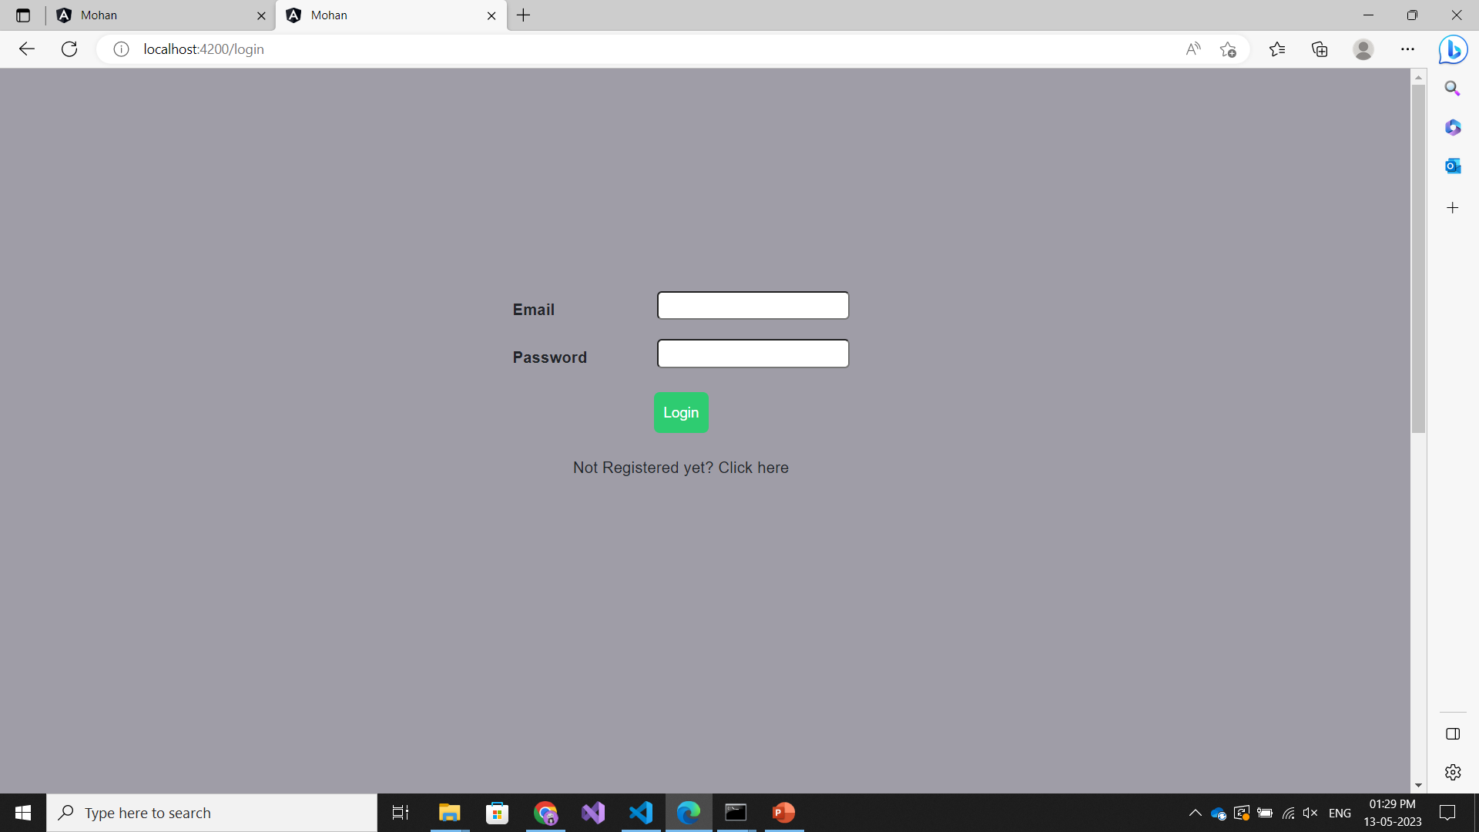
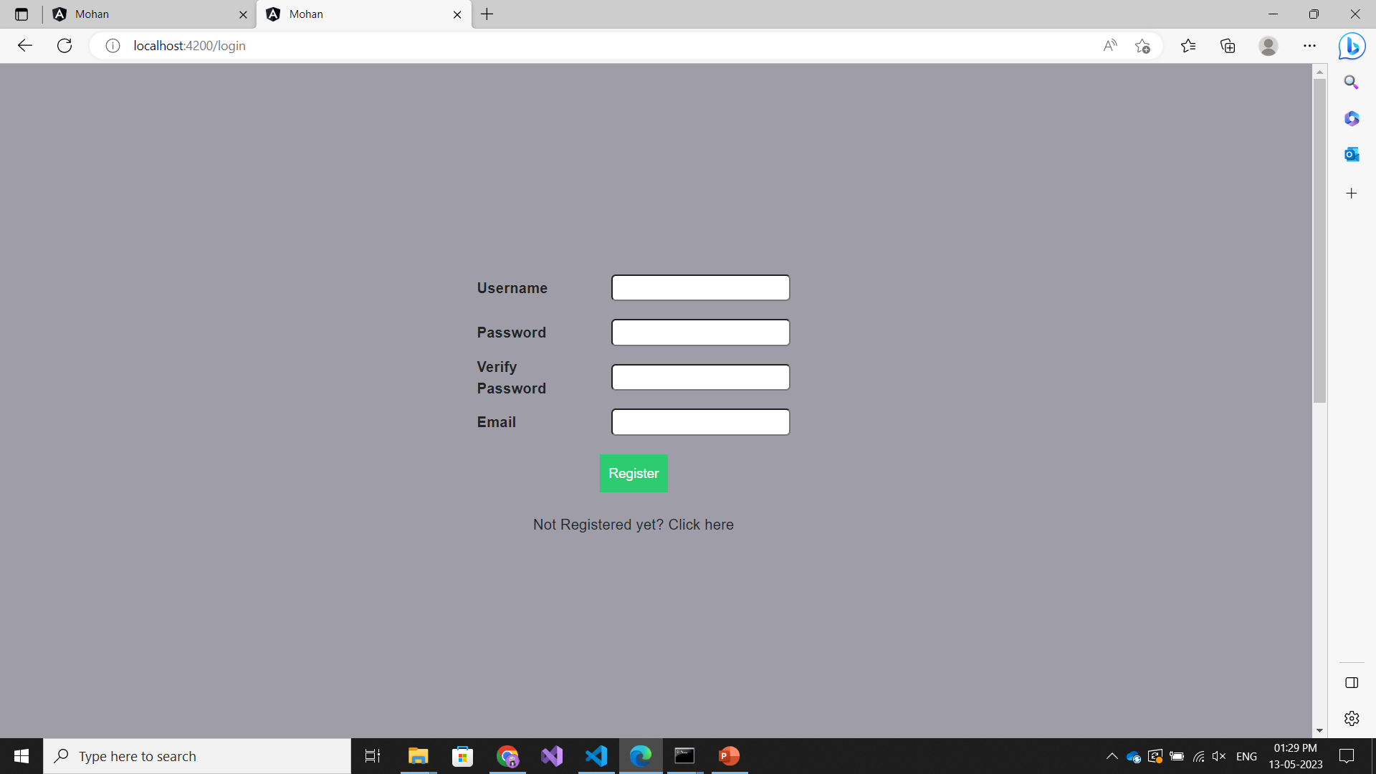
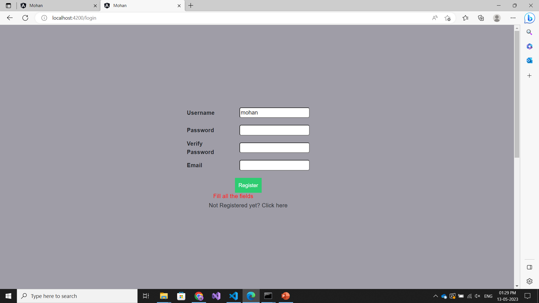
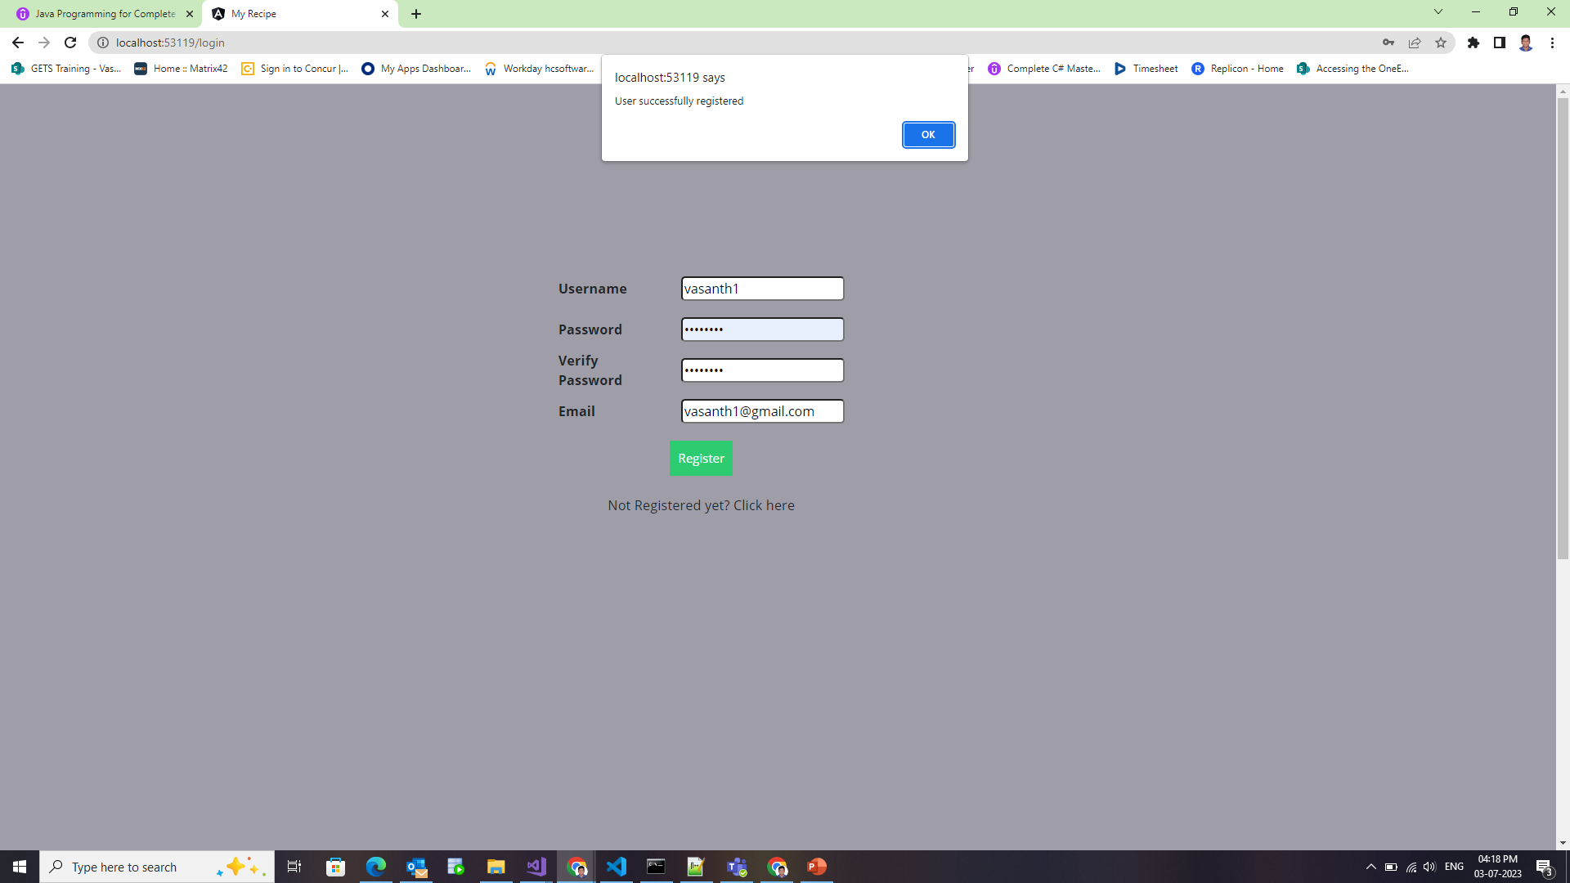

Slide 6
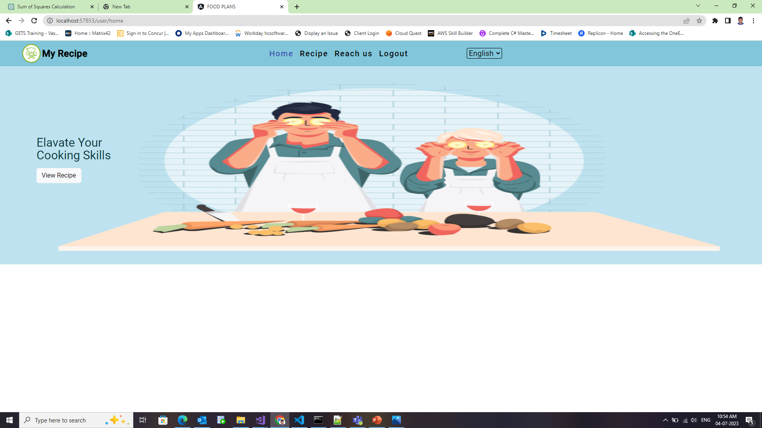
Userhome

Slide 7
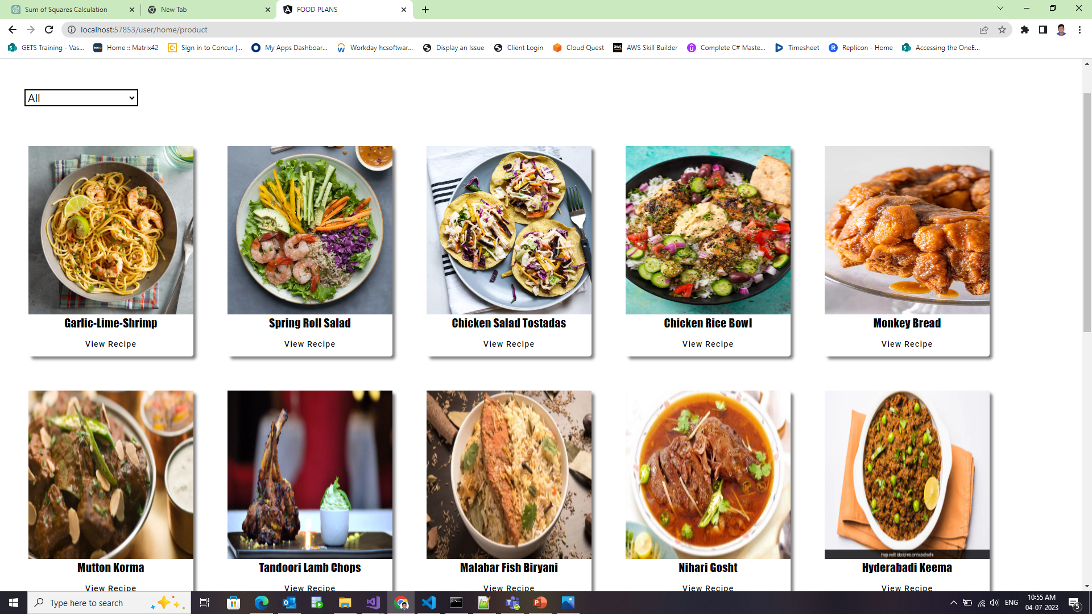

Slide 8
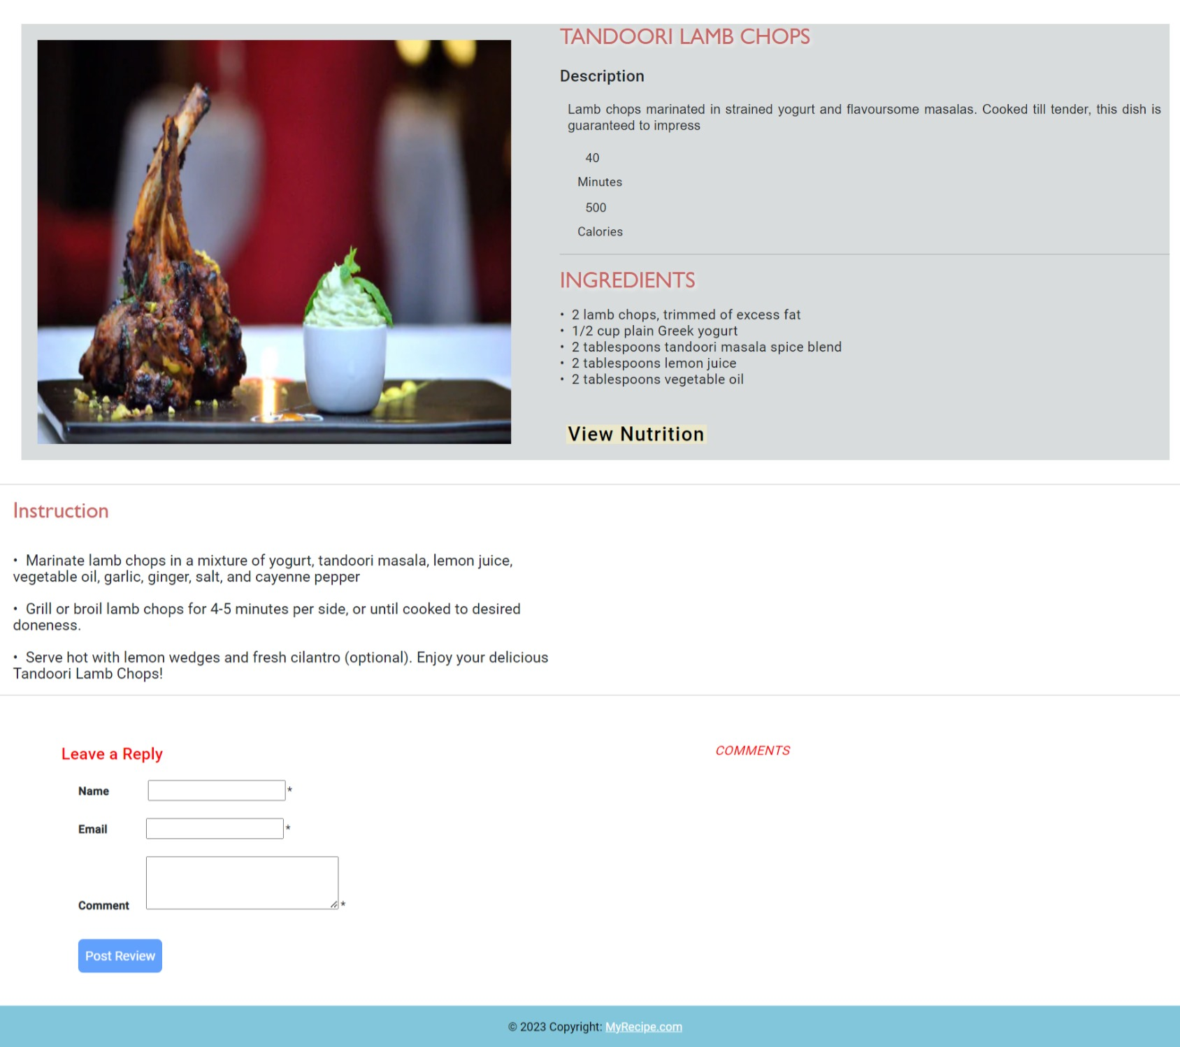
Details page

Slide 9
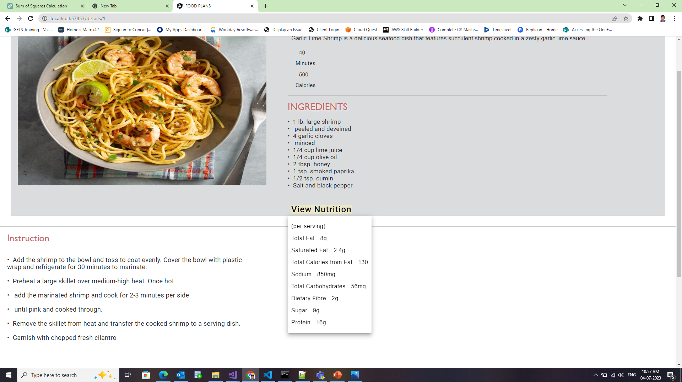

Slide 10
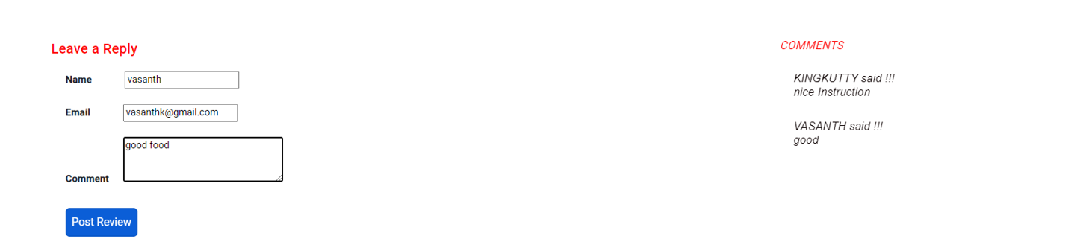
Review

Slide 11
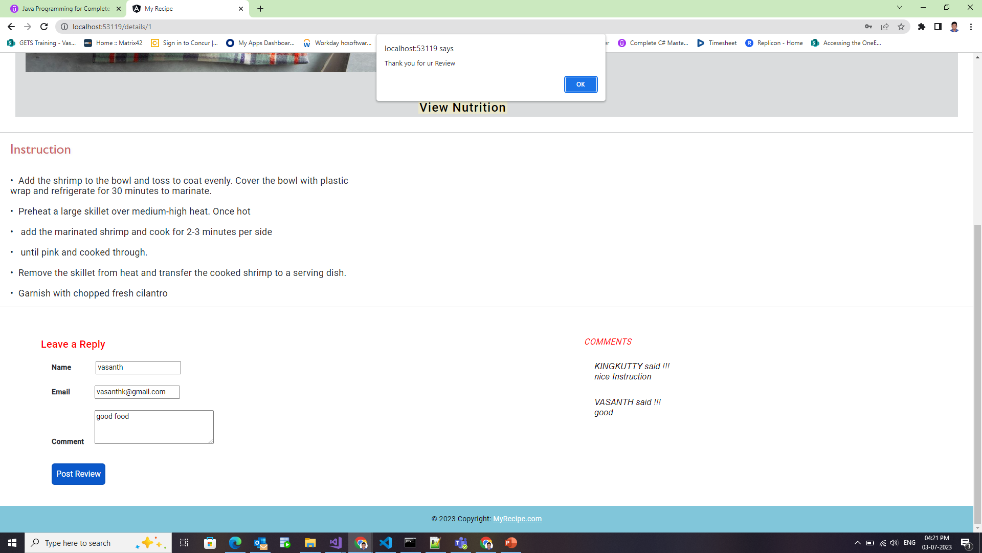

Slide 12
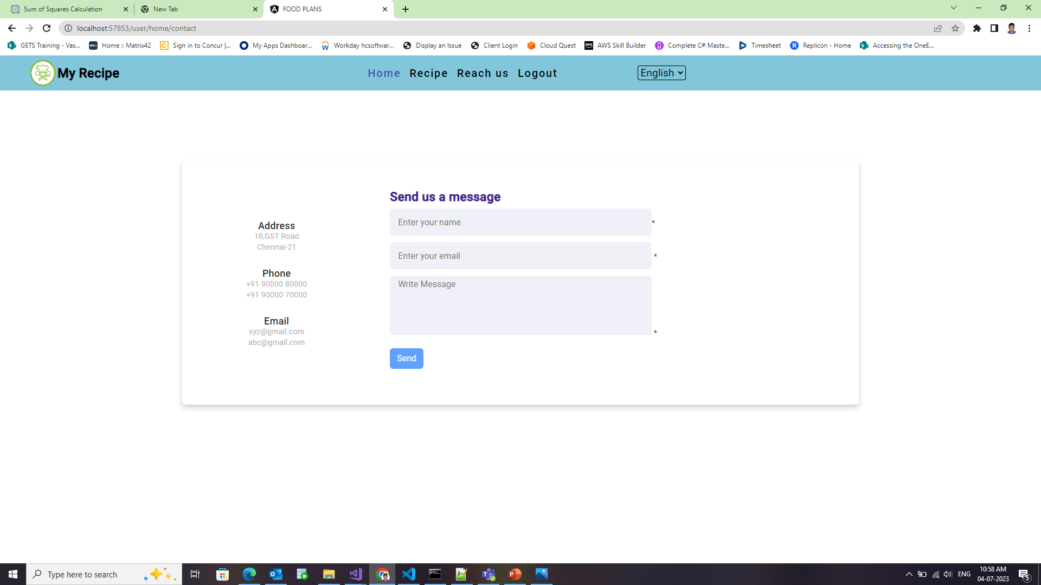
Reach us page

Slide 13
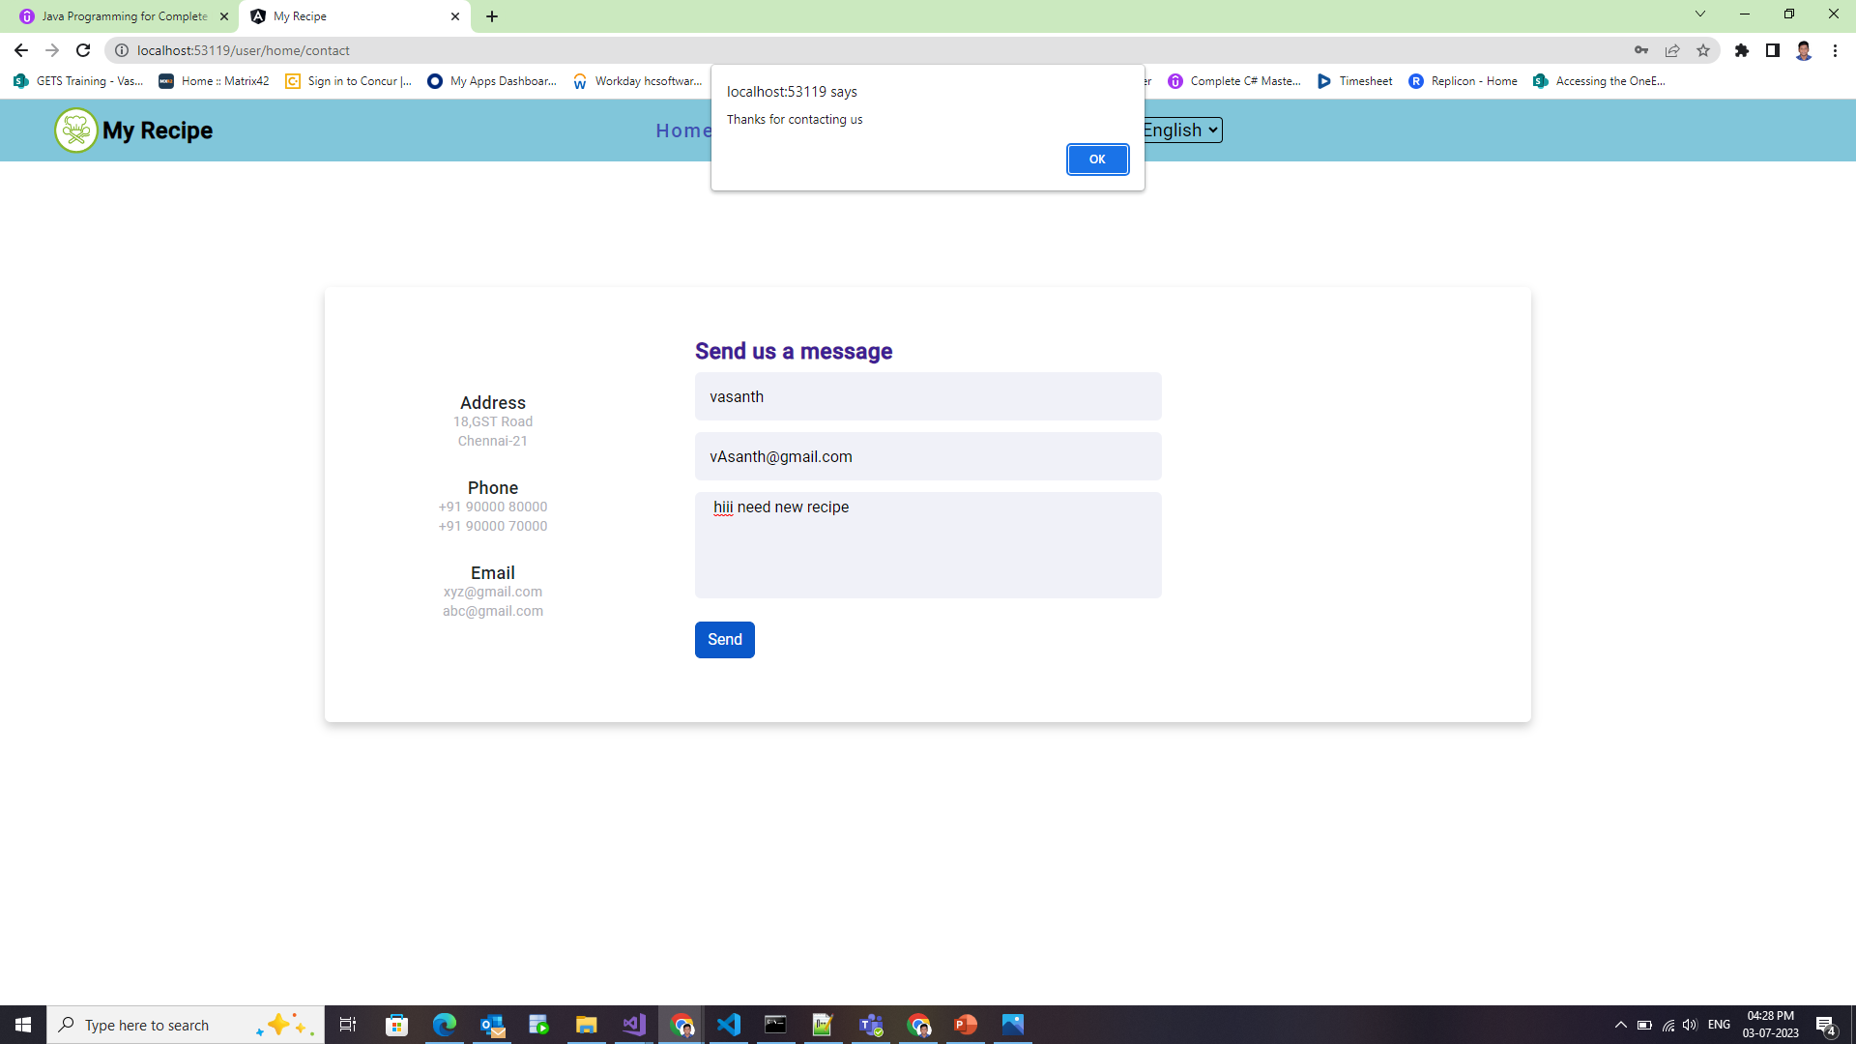

Slide 14
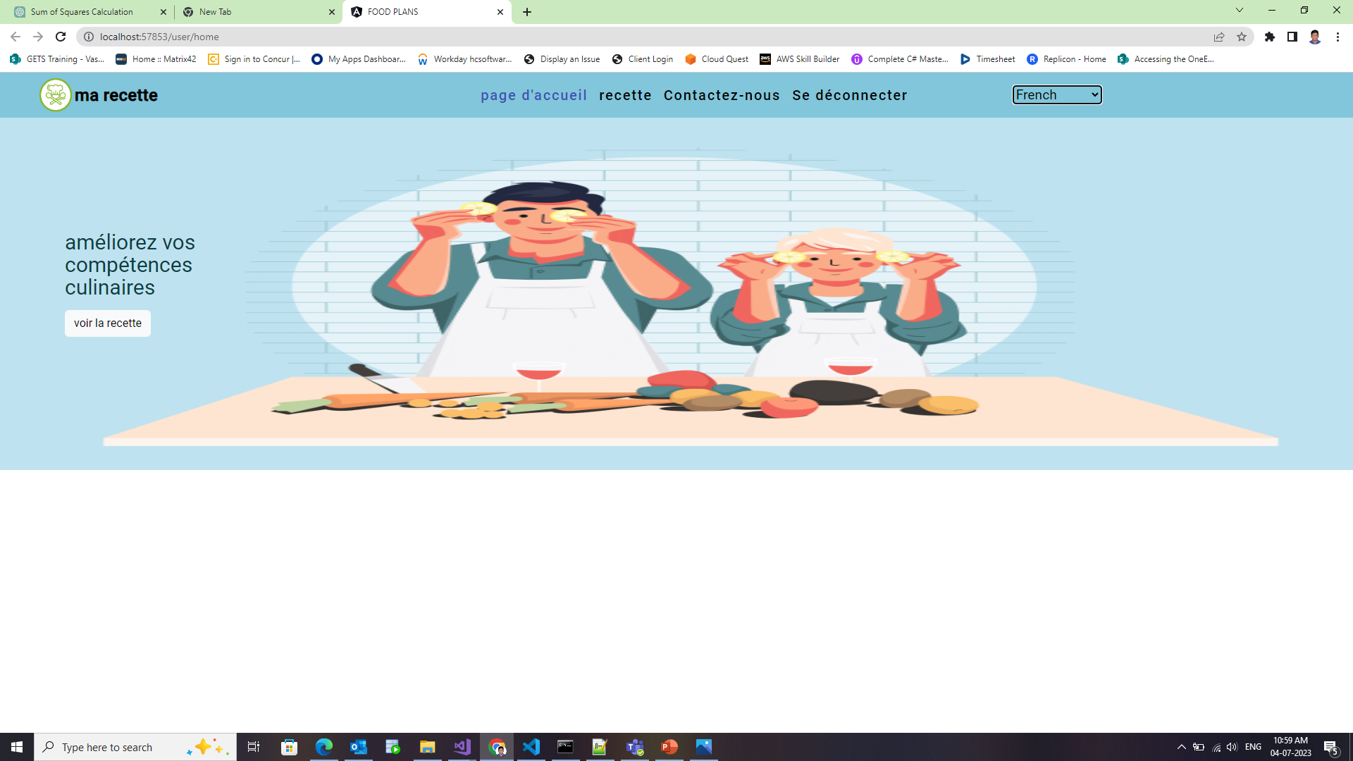
Internationalization

Slide 15
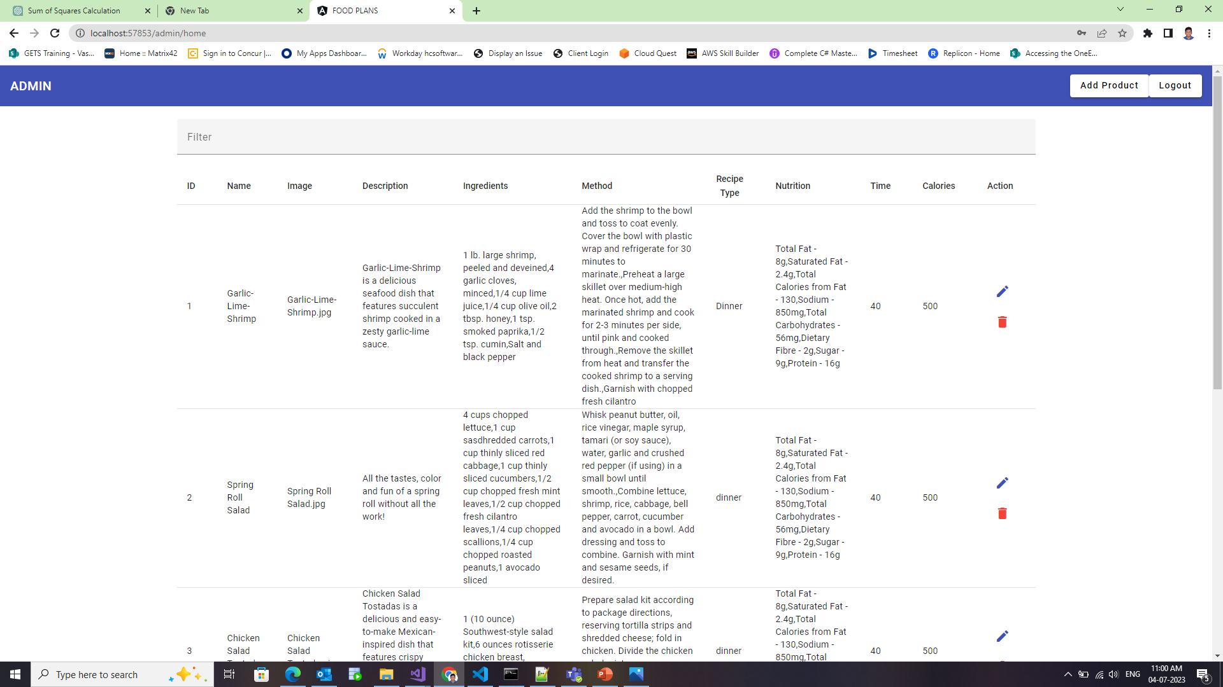
Admin page

Slide 16
